Slide 2
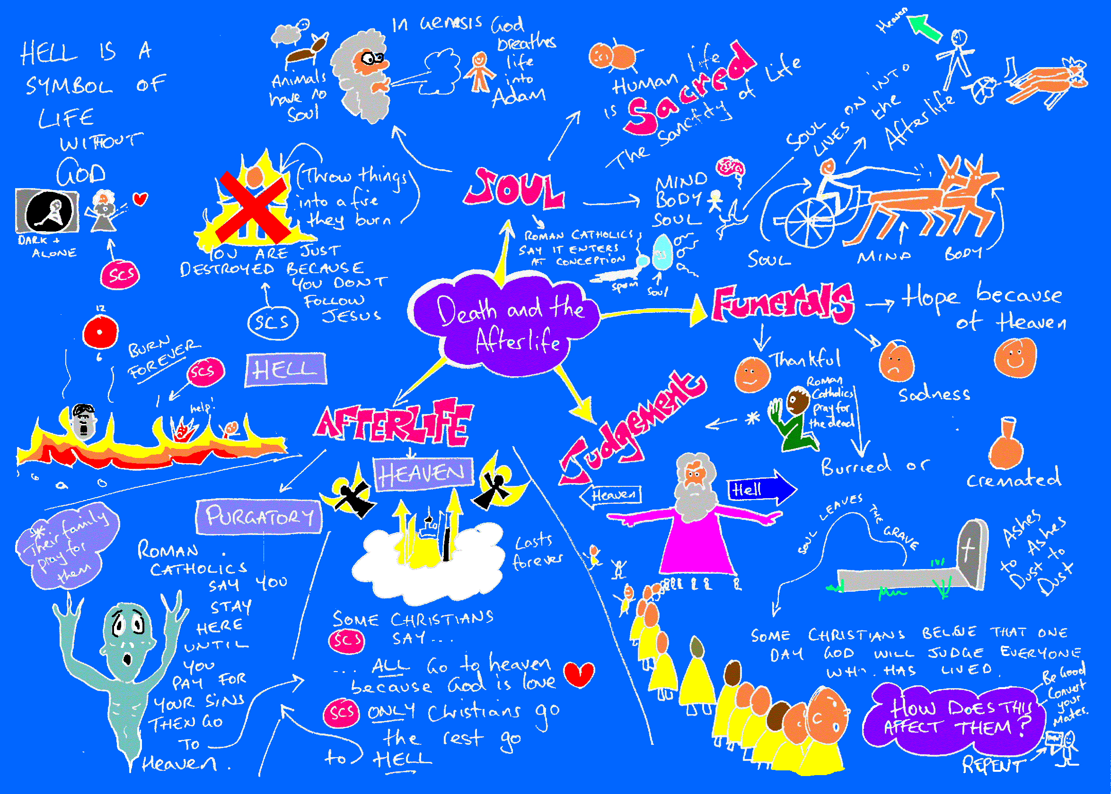

Slide 7
Body and Soul
Heaven, Hell and Purgatory
Philosophy Unit 3
The End of Life
Salvation, Redemption and the suffering of Christ
Sin and Atonement
Judgement
Funeral Rites

Slide 8
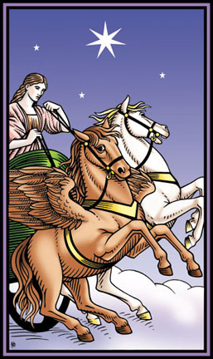
The Soul
The Soul is the non-physical part of us, the body is the physical part. Many religions share this idea e.g. Hindus with Atman and Brahman
It is also found in the writings of ancient Greek philosophers like Plato. According to Plato, the soul comes from, and will return to, a purer place and should not allow itself to be influenced and controlled by the desires of the body.

Slide 9
Most Christians believe that Humans have souls, and that animals don’t.
Genesis 1:27 – So God created man in his own image, in the image of God he created him; male and female he created them
St Francis of Assisi was an exception to this, referring to animals as his sisters and brothers, all created things united under God.
"Not to hurt the creatures brethren is our first duty to them,
but to stop there is not enough. We have a higher mission -
to be of service to them wherever they require it."

Slide 10
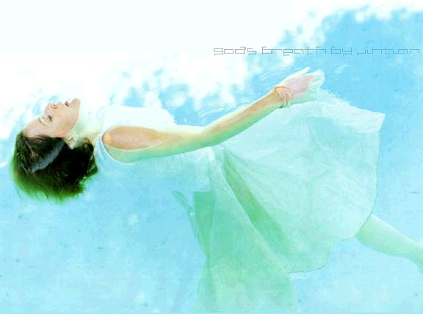
The Soul
Christians believe that God breathed life into Adam at creation.
The Lord God formed the man from the dust of the ground and breathed into his nostrils the breath of life, and the man became a living being
Genesis 2:7
The breath of God symbolises our uniqueness amongst all the animals
The breath of life is often taken to be a “metaphor” describing the soul.

Slide 11
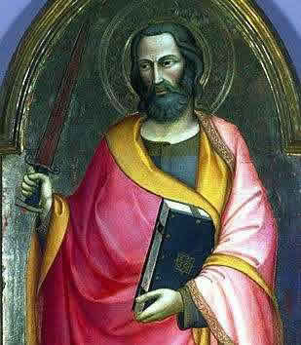
Body and Soul
In the New Testament Saint Paul taught that body and soul are actually in conflict. The soul desires to follow the wishes of God, but the body is led astray by the search for physical pleasure.
The body that is sown is perishable, it is raised imperishable; it is sown in dishonour, it is raised in glory; it is sown in weakness, it is raised in power; it is sown a natural body, it is raised a spiritual body. If there is a natural body there is also a spiritual body
(1 Corinthians 15:42-44)
In this quote the “spiritual body” may be the soul. The raising may take place in this life or after death

Slide 12
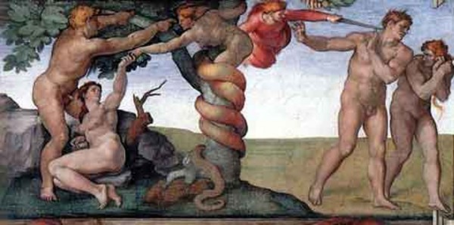
Sin and Atonement
According to Christian teachings, sin entered the world when Adam and Eve disobeyed God in the Garden of Eden and took the forbidden fruit. This is known as “original sin”. From then on, all people entered the world already burdened with sin. The sacrament of Baptism is thought to wash away this sin.
“When the woman saw that the fruit of the tree was good for food and pleasing to the eye, and also desirable for gaining wisdom, she took some and ate it. She also gave some to her husband, who was with her, and he ate it” Genesis 3:6-7
Some Christians teach that humans would have been sin-free and immortal if Eve had not introduced sin into the world.

Slide 13
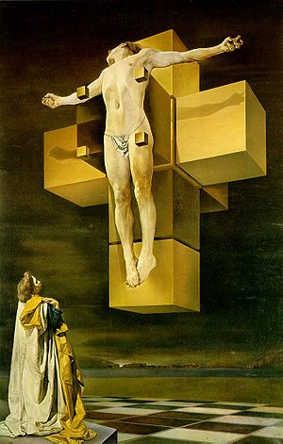
- Christians teach that Christ’s suffering and death atoned (made up for) the original sin of Adam and Eve. Human sin is forgiven by faith in Christ, and our immortal souls can reach heaven.
“Therefore just as sin entered the world through one man, and death through sin, and in this way death came to all men, because all sinned” (Romans 5:12)
For as in Adam all die, so in Christ all will be made alive”
(1 Corinthians 15:22)

Slide 14
Life after Death
What happens to us after we die? Christianity and other religions offer answers.
Some religions (Hinduism, Buddhism, Sikhism) teach about “Reincarnation”, the soul being born into another body. This is not a Christian teaching.
Our awareness of death is something that seems to differentiate us from animals

Slide 15
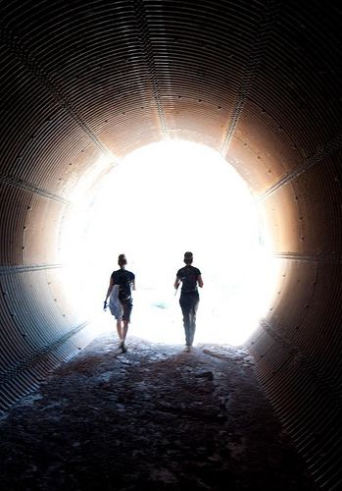
Sceptics would suggest that there is no proof for the existence of a soul. Therefore life after death is unlikely.
Sometimes “near-death experiences” are offered as evidence for survival beyond death. Others argue that this is not really scientific evidence.
Materialists and atheists would suggest that when we die, nothing else happens – we are dead. That is all.

Slide 16
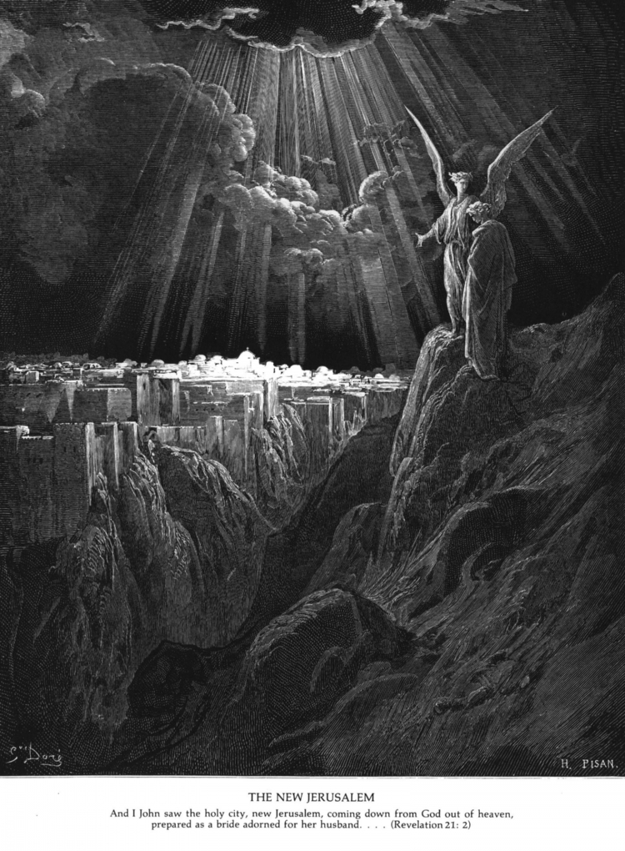
Heaven
*Christians believe that Jesus has given them the opportunity to reach heaven
*One day Christ will return (parousia, the Second Coming). At this point, all will be judged and sent to Heaven or hell according to the judgment made on the way they have lived their lives.
*This “Day of Judgment” will either happen as soon as a person dies (particular judgement) or at some date in the future when all we be judged (general judgement), remembering that God is not limited by our own puny human conception of time.
Some Christians believe that the “resurrection of the body” means that they will be reunited with their bodies, hence they disapprove of cremation

Slide 17
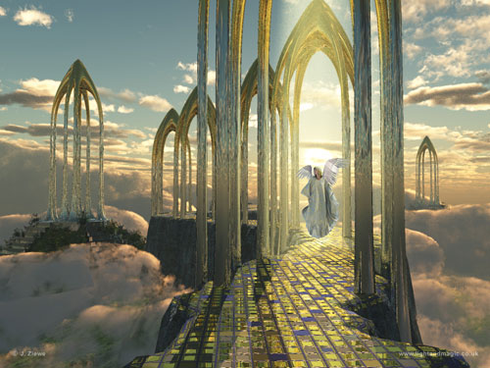
There have been different descriptions of heaven. Clouds and angels are artistic license, ways of describing things too complex for human language. But Christians agree on the “beatific vision”: an eternal and direct view of God, bringing total happiness
*Christians should not fear death, but should look forward to joy. Some Christians do not believe that heaven is a place – more like a state of mind

Slide 18
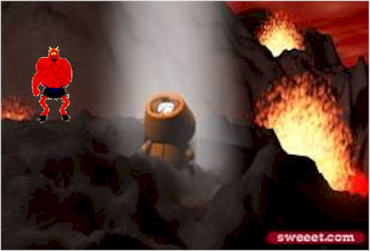
Hell
*The traditional Christian view was of Hell as a place of everlasting suffering. Some Christians believed that all who haven’t accepted Jesus will burn there for eternity.
*This is a less-popular view nowadays, with some Christians believing that Hell is more of a state of mind or denial of the “beatific vision”
*Many Christians still believe however that if you have not accepted Christ you cannot enter heaven. This only applies to those who have heard of Jesus and the Gospel
Some Christians argue that a loving God could never send someone to such a place.

Slide 19
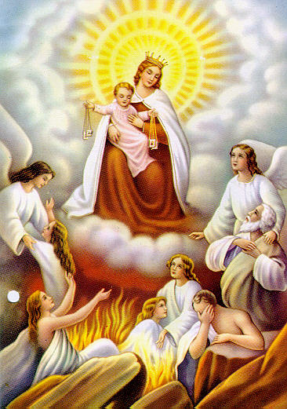
Purgatory
Roman Catholics believe in a middle place between Heaven and Hell called Purgatory.
In purgatory you pay for your sins such as envy or avarice (greed), until you are ready to enter heaven
This means that Roman Catholics will sometimes pray for dead people to help them to get into heaven
What is purgatory? Purgatory is the state of those who die in God’s friendship, assured of their eternal salvation, but who still have need of purification to enter into the happiness of heaven
From the Catechism of the Catholic Church

Slide 20
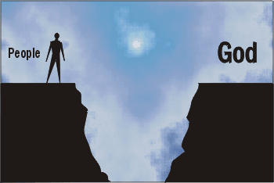
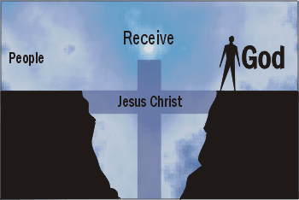
Salvation

Slide 21
Salvation, redemption and the suffering of Christ
Christians believe that they will receive salvation (be saved) and redemption (the act of delivering from sin or saving from evil) through devotion to Jesus.
“Therefore there is now no condemnation for those who are in Christ Jesus, because through Christ Jesus the law of the Spirit of life set me free from the law of sin and death” Romans 8: 1-2

Slide 22
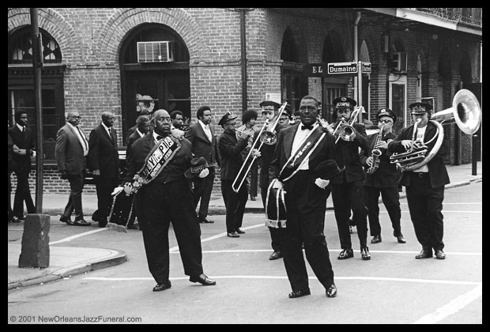
Funerals
Not all Christian Funerals are the same.
Some are a celebration of life..
Others will show that although loss is sad, there is hope in life after death.
Christians may be buried or cremated.

Slide 23
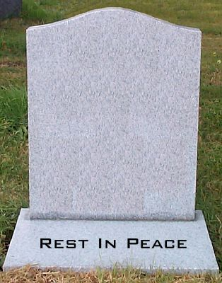
In many branches of Christianity Death is an important religious rite and should be prepared for properly.
Some Christians e.g. Roman Catholics, have a Requiem Mass, where prayers are said for the soul of the dead person.
Black is the colour of mourning, often with white flowers to symbolise hope and new life

Slide 24
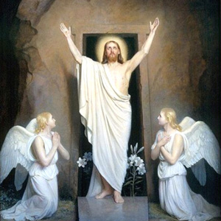
“I am the resurrection and the life. He who believes in me will live, even though he dies; and whoever lives and believes in me will never die” (John 11:25-26)

Slide 25
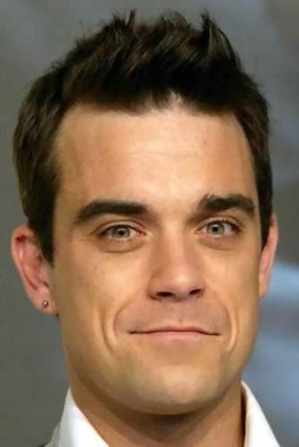
Secular (non-religious) funerals are often positioned more as a celebration of the life of the deceased. The services may be highly customised and personal, unlike many religious services. Perhaps unfortunately, the service may feature pop music – apparently Robbie Williams’ – “Angels” is quite a popular choice!

