Slide 1
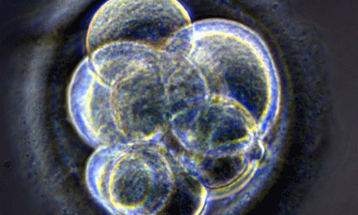
Full course session 1
Ethics Paper 1 - Topic 8
Religion and Medical Ethics

Slide 2
Structure of the RS GCSE Course
Ethics Paper 1 (15th May) – 1 hr
7. Religion and human relationships
8. Religion and medical ethics
9. Religion, Poverty and Wealth
Ethics Paper 2 (15th May) – 1 hr
10. Religion, peace and justice
11. Religion and equality
12. Religion and the media
Short Course unit – in class
Full Course Unit – after school
Units not being taught
Philosophy 1 (15th June) – 1 hour
Beliefs about deity
Religious and spiritual experience
The end of life
Philosophy 2 (15th June) – 1 hour
Good and Evil
Religion, Reason & Revelation
6. Religion and science
You will answer questions
(a-e) on 2 of the 3 topics on each of the papers

Slide 3
Full course session 1
Ethics Paper 1 - Topic 8
Religion and Medical Ethics

Slide 4

Use this site:www.hbkgcsere.weebly.com
Twitter:
@hbkre
For revision updates and bants

Slide 5
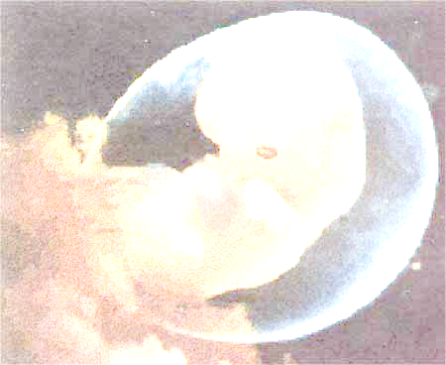
The Sanctity of Life
Meaning something ‘special’ or ‘holy about life
Human life is more important than other forms of life
We share something of the nature of God – are ‘made in his image’. God breathed into us the breath of life, usually interpreted as giving us our souls.
The soul does not die
Christians believe that God has a ‘plan’ for each of our lives

Slide 6

‘So God created man in his own image, in the image of God he created him’ (Genesis 1:27)
‘My frame was not hidden from you when I was made in the secret place. When I was woven together in the depths of the earth, your eyes saw my unformed body. All the days ordained for me were written I your book, before one of them came to be’
(Psalm 139:13-16)
*Christians believe that everyone, whatever their status or condition, has value
*Christians should treat their own lives as a valuable gift
‘Don’t you know that you are Gods temple and that God’s spirit lives in you? If anyone destroys God’s temple, God will destroy him; for God’s temple is sacred, and you are that temple
(1 Corinthians 3:16-17)

Slide 7
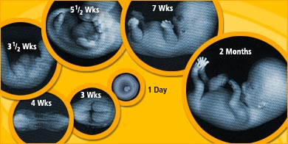
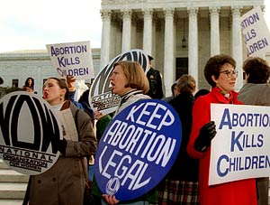
Abortion
An abortion is where a foetus is expelled from its mother’s uterus before it reaches full term.
An abortion is a deliberate act, rather than a miscarriage
The legal limit for abortion in the UK is 24 weeks. Abortion legislation varies from country to country

Slide 8
The Law
Two doctors have to agree for an abortion to take place
The decision may take into account: any risk to the mother’s life; risk to the mother’s physical or mental health; welfare of existing children in the family; risk of abnormalities in the child
Abortion illegal before 1968, the Law was amended (28 to 24 weeks in 1990)
The Christian view on Abortion
*There is no clear guidance on abortion in the Bible
*Christians are divided on the issue
*The Roman Catholic Church regards all involved in procuring and carrying out an abortion as guilty of a grave sin
*Some Protestant churches would be prepared to look at the circumstances of individual people
*All Christians would agree with giving guidance and support to people facing tough situations and decisions.
Key Ethical Question: Is the foetus a person?

Slide 9
Church Teachings
Early Christians taught that “abortion is murder only when a foetus is formed.” The foetus was believed to be fully formed at 40 days for a male and 90 days for a female. This was the time of ‘ensoulment’, when the soul entered it and the foetus became a person.

Slide 10

Catholic Teachings
In 1869 Pope Pius IX declared that the foetus became “ensouled” at conception and, therefore, all abortions were murder.
In 1917 the new Code of Canon Law declared that for Roman Catholics abortion was a sin at any stage in the pregnancy.
The Catholic catechism (1997) states that ‘human life must be respected and protected absolutely from the moment of conception… abortion and infanticide are abominable crimes’
This is an absolute principle, although the doctrine of ‘double effect’ could be used, for example during an ectopic pregnancy. In this case removing the embryo (developing in the fallopian tubes) is designed to save the life of the mother first and foremost, not kill the embryo.

Slide 11
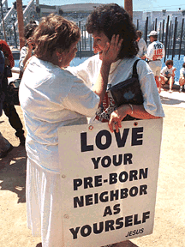
“The Anglican view on abortion is that although the foetus is to be specially respected and protected, nonetheless, the life of the foetus is not absolutely sacrosanct if it endangers the life of its mother.”(Church of England report, 1984)
“Circumstances which may justify an abortion are direct threats to the life or health of the mother, or the probable birth of a severely abnormal child.”(Methodist Statement, 1980)

Slide 12
Other Christian positions on abortion:
Methodist Church – abortion is always an evil, prefer adoption. Abortion lesser of two evils in cases of rape, handicap or risk for the mother
Baptist Church – We should protect the life of the foetus, with similar exceptions to the Methodists
Salvation Army – life is sacred from conception, but with similar exceptions again
United Reform Church – early abortion is more acceptable than a late abortion
Quakers – abortion is unacceptable with a few exceptions, as before
Many of these Christian groups have a relative approach to the morality of abortion – they adapt their approach to different circumstances. This is the opposite of the Catholic absolute approach to morality. All Christian groups emphasise the importance of compassion.

Slide 13

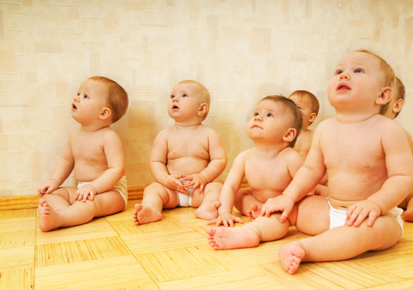
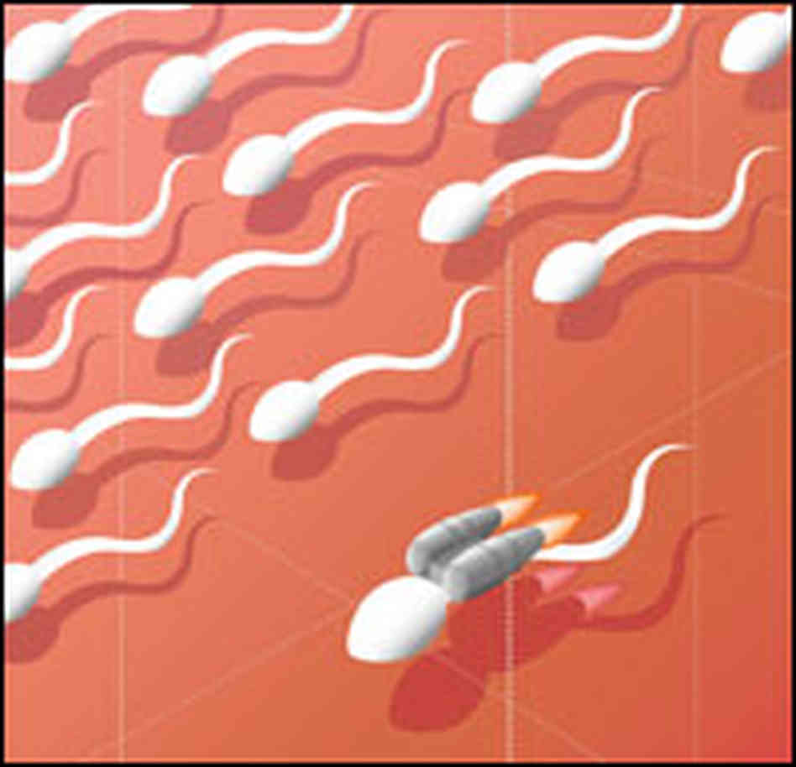
Fertility Treatment

Slide 14

Artificial Insemination (AI)
Fertility Treatment

Slide 15
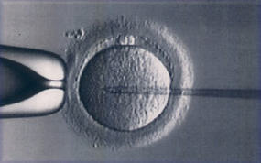
In vitro fertilisation (IVF)
Fertility Treatment

Slide 16
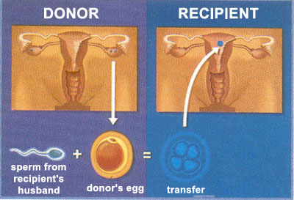
Egg donation
Fertility Treatment

Slide 17
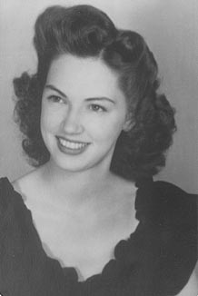
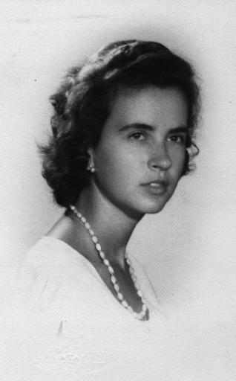
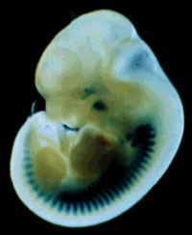
Embryo donation
Fertility Treatment

Slide 18
Some Christians think that fertility treatment is a form of adultery and so it is morally wrong. (Roman Catholics teach this).
They also think that if God didn’t want you to have a baby then you shouldn’t try to interfere with his wishes. (In the Bible Sarah was barren ‘because the Lord had closed her womb’ (1 Samuel 1:5) The Catholic Catechism states ‘Life is God’s gift and we do not have the right to children’
Quite often there are ‘spare’ embryos formed when IVF is used. Some Christians think it is wrong to destroy this life as it was a person from the moment of conception.

Slide 19
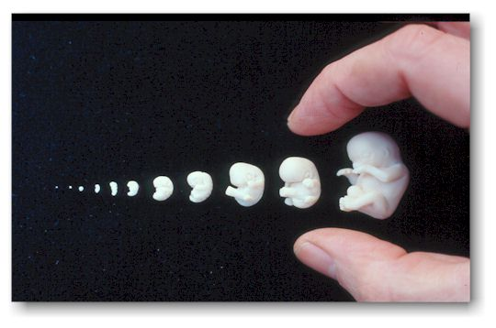
Other Christians say that as Jesus healed people it is not wrong to try to heal people of their infertility. They say that it is an act of love and Jesus said ‘love your neighbour as yourself’.
The Church of England ‘(supports) the recommendation that research, under license, be permitted on embryos up to 14 days old and agree that embryos should not be created just for scientific research’

Slide 20
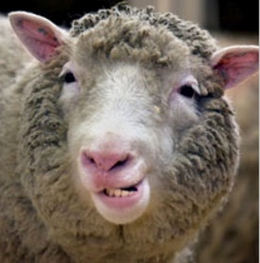
Cloning
Cloning creates a genetically identical animal or plant from another.
*Dolly the sheep was the most famous clone
*There is widespread concern about the possibility of cloning humans – it is illegal
*Christians feel that cloning is against the Will of God – he created each person as a unique individual
*We should not ‘play God’
*Cloning is against the Catholic Teaching on the sanctity of life. Humans should not be seen as tools for science nor as a means to an end.

Slide 21
Suicide and Euthanasia
Christians believe that suicide is wrong because:
God chooses when people are born and when they die
Sometimes God requires us to suffer for a specific and important reason
By suffering we can come closer to God. We should not try to escape this.
Suicide can be viewed as selfish e.g. its impact upon those left behind, family etc.
Murder goes against an important commandment. Suicide is a form of self-murder.
Christians do believe that people in these difficult situations should be supported with compassion. One Church of England minister, Chad Varah, started an organisation called The Samaritans to help people going through difficult times.

Slide 22
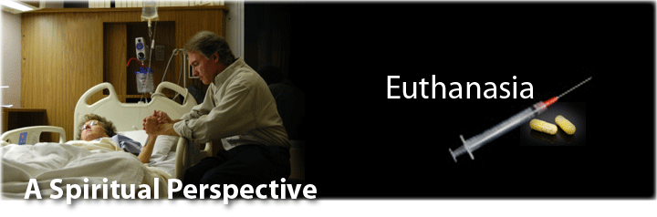
Euthanasia
Euthanasia is a word derived from the Greek language.
It means ‘a good death’. If a person believes in euthanasia, it means that they are in favour of allowing people the right to commit suicide, or be killed by others, usually when a person has an incurable or excruciatingly painful medical condition.
There are four kinds of euthanasia:

Slide 23
Euthanasia
i) Passive Euthanasia
Allowing people who are being kept alive artificially to die. (ie. by switching off a life support machine). In effect they die from their illness or injury.

Slide 24
Euthanasia
ii) Active Euthanasia
Killing someone to end suffering, commiting suicide, or assisting someone to commit suicide. This might be a lethal injection, or overdose, for example.
iii) voluntary euthansia (where someone makes the decision for themselves and asks for help)
iv) involuntary euthansia, where the decision is taken without the individuals consent

Slide 25
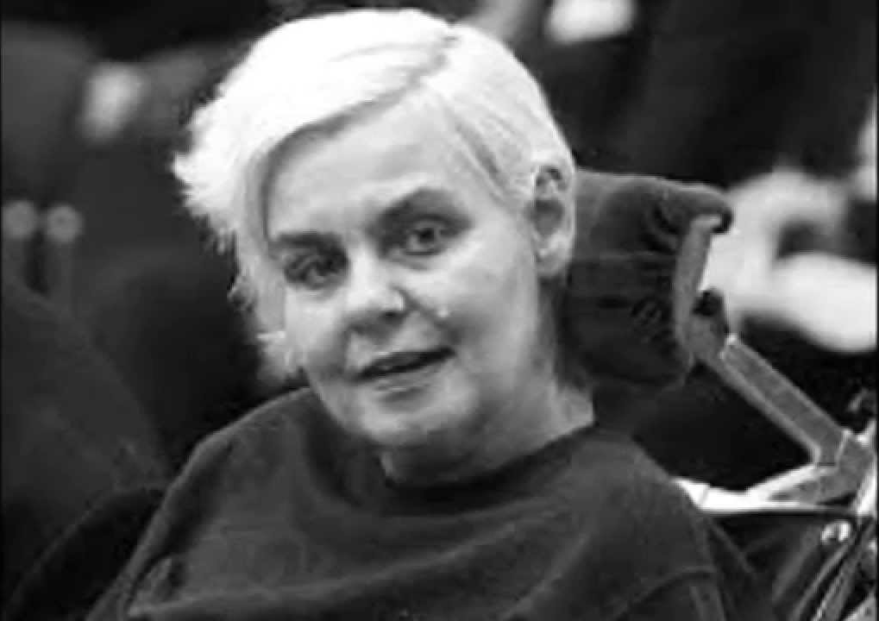
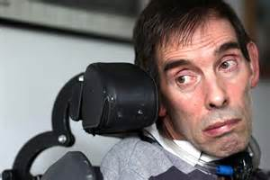
Euthanasia
Dianne Pretty & Tony Nicklinson
In Britain, passive euthanasia is sometimes legal. This was established in the High Court when an action by a pressure group against turning off the life support machine of brain-dead Hillsborough victim Tony Bland was thrown out of court. Doctors can decide to switch off life support machines after consulting with relatives.
In Britain, active euthanasia remains illegal.

Slide 26
Euthanasia – in favour
a person’s body is their own, therefore they should have the right to do with it as they wish.
one of the main aims to life is happiness. If illness and disease mean that there is no happiness, then the point to life is missing and a person may be justified in taking their life.
in many cases euthanasia is a blessing to relatives allowing them to mourn the loss of their loved one, without having to see them suffer.
to assist someone to die is not an act of violence but an act of love.

Slide 27
Euthanasia - against
in some cases there may be a chance of recovery. A cure might be discovered.
the feelings of family and friends may be upset by a ‘selfish’ decision.
if we allow euthanasia because someone has no quality of life, doctors may allow relatives to kill old people on the grounds that they are unhappy
life is a gift, maybe even a gift from God. No matter how bad the pain is, we must hold on to life at all costs. No one has the right to ‘play God’.

Slide 28
Euthanasia - methods
Turning off a life support machine
Putting a pillow over a patient's head
Stopping doctors from resuscitating a baby
Allowing a brain-dead person to starve to death
Giving a patient a lethal injection of morphine
Withdrawing food or medication

Slide 29

Why are Christians often opposed to euthanasia?
Many Christians are opposed to euthanasia.
Some Christians accept that passive euthanasia is acceptable under certain conditions. A few Christians will accept active euthanasia on the grounds of compassion and love.

Slide 30
Why are Christians often opposed to euthanasia?
1. Human life is a gift from God, only God can take it away. The timing of death should be left to God.

Slide 31
Why are Christians often opposed to euthanasia?
2. In the Bible (1 Corinthians 3:16) St Paul says that the body is the ‘temple of the Holy Spirit’. This means that the body is holy and should not be destroyed for any reason.

Slide 32
Why are Christians often opposed to euthanasia?
3. Christians believe in God’s Plan. Because of this they do not accept that ending life prematurely is reasonable. Suffering may be serving some purpose.

Slide 33
Why are Christians often opposed to euthanasia?
4. The Hospice Movement seeks to provide a peaceful and comfortable environment for people to die in.

Slide 34
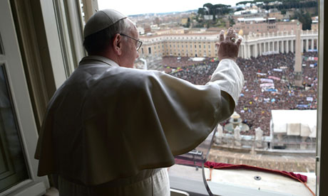
Roman Catholics are opposed to all forms of euthanasia. They believe very strongly in the sanctity of life.

Slide 35
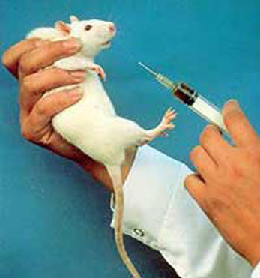
The use of animals in medical research
The Bible teaches human superiority. Some animal rights groups would regard this as ‘species-ist’
Christ taught compassion and that God was aware of all living creatures

Slide 36
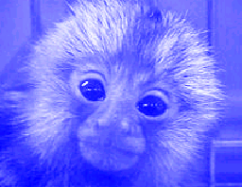
Christian views
The Book of Genesis says, ‘I will make humans to have dominion over the fish in the sea, the birds of the air, the cattle, and all the wild animals on the Earth. Humans will spread over the earth and subdue it’.
Dominion means to rule over the earth.
Subdue means to make obedient.

Slide 37
Christian views
Pope John-Paul 2 said, ‘Scientists must abandon laboratories and factories of death.’
‘Medical and scientific experimentation on animals is morally acceptable if it remains within reasonable limits and contributes to caring for or saving human lives’ (Catholic catechism)
‘Human beings have both an affinity with and an obligation to animals’ (Church of England report)

Slide 38
Christian views
Simon Phipps, former Bishop of London said, ‘God is father and we are his children...Animals are part of God’s family. .’
St Francis of Assisi felt that animals should be treated with compassion, just like Jesus helped the weak and helpless
For many Christians the question of animal experimentation is a matter of individual conscience, rather than obeying church teaching

