Slide 1

Philosophy and Applied Ethics – Full Course
(OCR J621)
Beliefs about deity

Slide 2

Key terms for describing God
Key term | Meaning
Anthropomorphic | Describing something non-human in human terms
Judge, Shepherd, Warrior, King, Father
Omnipotent | All powerful
Omniscient | All knowing
Omnibenevolent | All loving
Omnipresent | Present everywhere
Transcendent | Above all
Immanent | Within all
Impersonal | Mysterious holy force for good
Personal | Connected with individuals feelings and emotions

Slide 3
Different ways language is used to discuss religion
Type of language | Explanation
Analogy | Words used symbolically to suggest something else (not quite equal though – i.e. My dog is good is different to God is good)
Myth | A story which is not factually true but has important spiritual truths. I.e. Is Genesis a myth?
Symbol | A way of explaining the unexplainable – i.e. The Cross.

Slide 4
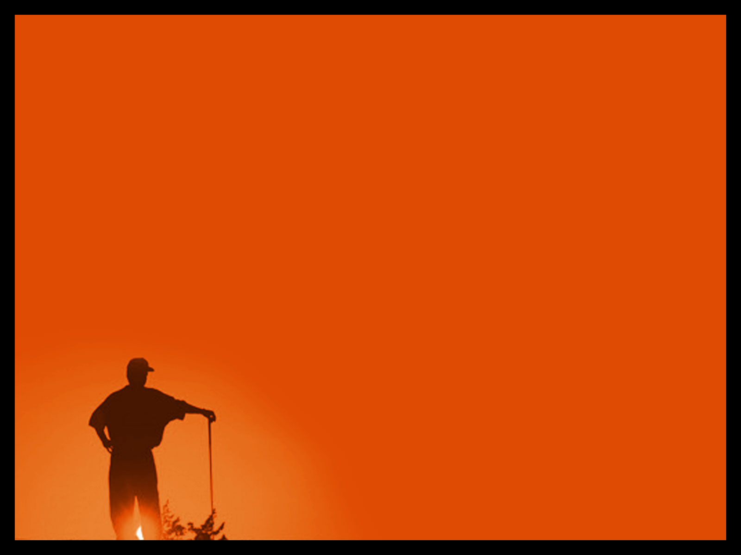
Belief…
An Atheist believes…
There is no God and those who believe in God are mistaken.
People should stand on their own 2 feet and not rely on belief in God.
God is not real or ever could be.
God is only in the minds of those who believe.

Slide 5
Belief…
An Agnostic
God might exist but they are not sure.
It will never be possible in this life to know if God exists or not.
Any proof of the existence of God is beyond all human knowledge and understanding.

Slide 6

The Nature of God
Monotheistic and Eternal
Male | Female | Neither
‘All things have been committed to me by my Father. No one knows the son except the Father, and no one knows the Father except through the Son and those whom the Son chooses to reveal him’ Matt 11:27 | ‘As a mother comforts her child, so will i comfort you’ (Isaiah 66:13) Julian of Norwich refers to God in her book ‘Revelations of Divine Love’ as a mother | ‘No one has ever seen God; but if we love one another, God lives in us and his love is made complete in us’ (1 John 4:12) ‘You cannot see my face, for no one my see me and live’ Exodus 33:20 ‘God is spirit, and his worshipers must worship in spirit and in truth’ John 4:24
‘God said ‘Let us make man in our image’ (Gen 1:26) – original Hebrew refers to the whole of humanity rather than just male. Image of God is not necessarily a physical characteristic and therefore may not refer to gender issues.

Slide 7
The Trinity
The Trinity Triangle
JC
The Trinity is the Father, Son and Holy Ghost.
Each part of the Trinity is separate – Jesus Christ is not the father, nor is the Holy Ghost Jesus Christ.
God is known through each different part – Father, Son and Ghost.
God
God
Father
Spirit

Slide 8
God the Father
Calling God ‘Father’ humanised him.
It was a way of teaching people that God loved and cared for them – just as a good human father cares for his children.
The Trinity
God the Son
Christians believe the most complete revelation of God has come to them through Jesus.
He was born as ‘God in flesh’ – the son of God and of the Virgin Mary.
Here he was able to show something of the true nature of God.
He died on the cross so that sins could be forgiven. He was resurrected from the dead and ascended into Heaven.
God the Holy Ghost
After Jesus returned to Heaven, he sent his Holy Spirit to guide his followers into all truth.

Slide 9
This is summed up in the Nicene Creed
I believe in one God the Father Almighty, Maker of heaven and earth, And of all things visible and invisible: And in one Lord Jesus Christ, the only-begotten Son of God, Begotten of his Father before all worlds, God of God, Light of Light, Very God of very God, Begotten, not made, Being of one substance with the Father, By whom all things were made;
Who for us men, and for our salvation came down from heaven, And was incarnate by the Holy Ghost of the Virgin Mary, And was made man, And was crucified also for us under Pontius Pilate. He suffered and was buried, And the third day he rose again according to the Scriptures, And ascended into heaven, And sitteth on the right hand of the Father. And he shall come again with glory to judge both the quick and the dead: Whose kingdom shall have no end.
And I believe in the Holy Ghost, The Lord and giver of life, Who proceedeth from the Father and the Son, Who with the Father and the Son together is worshipped and glorified, Who spake by the Prophets. And I believe one Catholick and Apostolick Church. I acknowledge one Baptism for the remission of sins. And I look for the Resurrection of the dead, And the life of the world to come. Amen.[1]

Slide 10
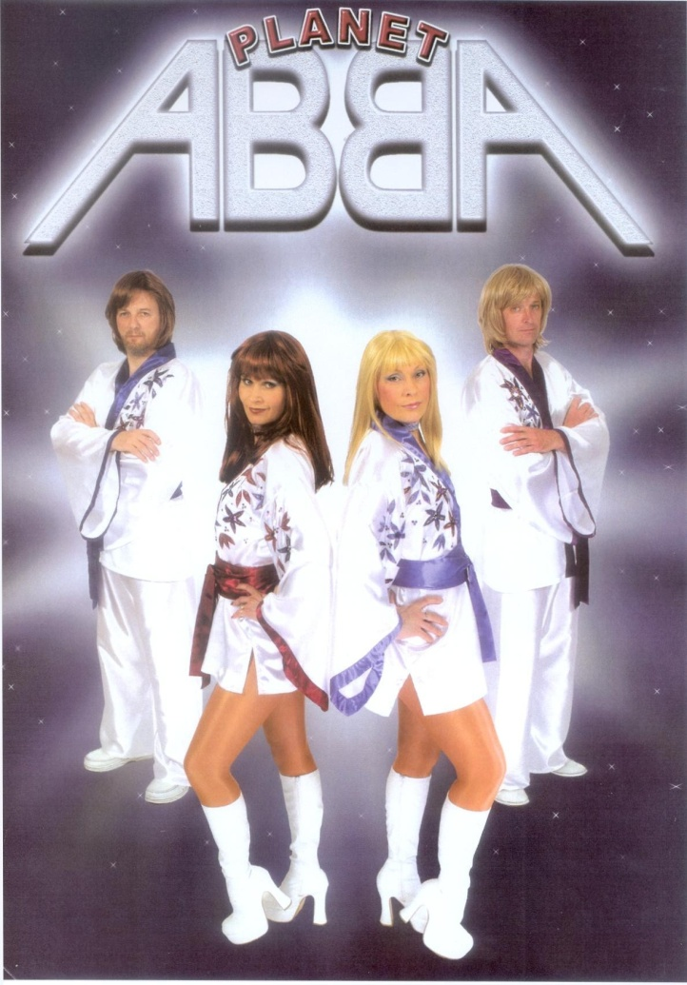
Natural but unanswerable curiosity. Solution?
Whilst God is described in the Bible as both transcendent and immanent the key teaching for Christians is in how Jesus taught his followers to pray, opening each prayer with ‘Our Father’.
Whilst God is the author of the entire creation he is also the close and cares for even the smallest part of creation.

Slide 11
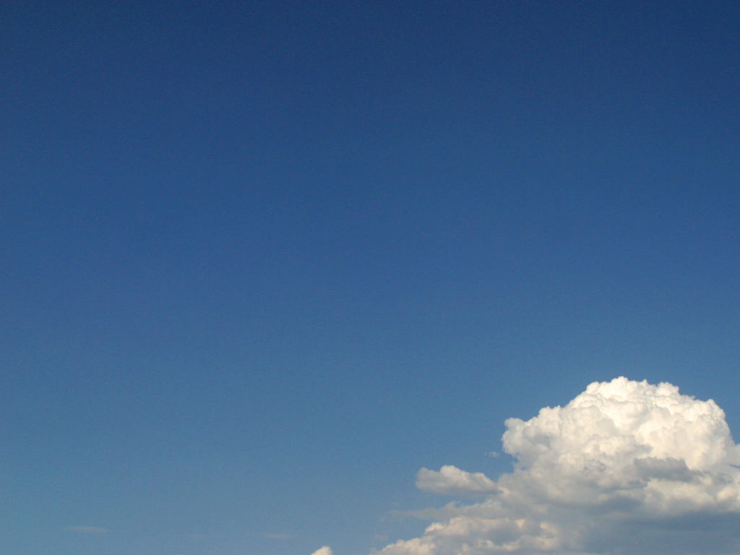
Why do Christians
believe in God?
Reason One:
The world that we live in cannot exist without an all-powerful (omnipotent) God who created it.
William Paley and the Design (Teleological) Argument.
Imagine that you come across a watch lying in the sand, you open it and find a finely balanced arrangement of wheels and cogs.
Can anyone honestly think that this just appeared by accident? Or does it imply a watchmaker?
How does this apply to the universe?

Slide 12
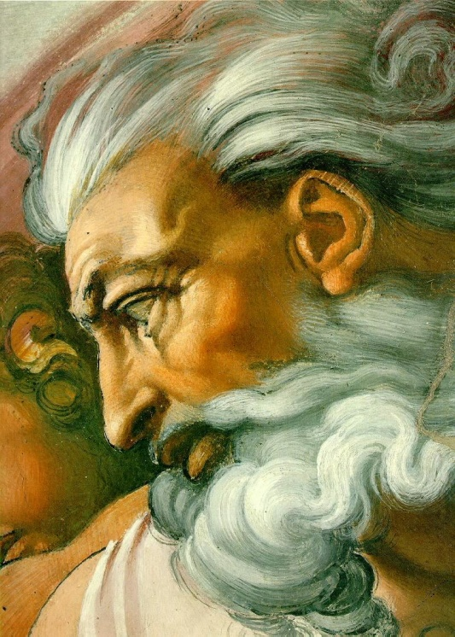
Why do Christians
believe in God?
Reason Two:
We know right and wrong because we have a conscience.
Christians believe the conscience comes from God – he lets them know what he expects from them.
Some people’s conscience might be stronger than others, but it is still there in everyone.

Slide 13
Why do Christians
believe in God?
Reason Three:
Many people believe they have met God, and they can’t all be wrong!
The may have witnessed a miracle, or felt close to God through reading the Bible.
They may have had a revelation while worshipping that brought about a divine inner feeling of Love and Peace.
If people experience God, then He must exist!

Slide 14
Why do Christians
Believe In God?
Some people’s belief in God stems from their upbringing.
The family has read the Bible and prayed together.
They cannot remember a time when they didn’t believe in God or go to Church.
They do not need to be convinced of God’s existence – they just ‘know’.

Slide 15

What is a miracle?
  Something out of the ordinary
  Intended by God as a sign on his love and/or power
  A marvellous event that is said to be performed by God as it could not have been brought about by humans
  Expresses control over the laws of nature

Slide 16
Miracles & Christian Tradition
Christianity is founded on the tradition of miraculous events
  Incarnation and Resurrection
  ‘I lay down my life – only to take it up again. No one takes it from me but I lay it down of my own accord. I have authority to lay it down and authority to take it up again’ (John 10:17f)
Water into wine, walked on the sea, healed the sick, raised the dead, calmed a storm and exorcised demons.
Born of a Virgin and came back from the dead
  ‘The Word became flesh and made his dwelling among us. We have seen his glory, the glory of the One and Only, who came from the Father, full of grace and truth’ (John 1:14)

Slide 17
Literal?
Some Christians value the spiritual message behind the story rather than seeing the miracle account as literal.
  Miracle called a ‘Seimeion’ in anc. Greek – a sign.
  Sign to Jesus’ Messiahship and therefore a sign of God’s love and intervention in the world to both believers and non-believers.

Slide 18
Aquinas and the miracle definition
‘those things done by divine power apart from the order usually followed in things’
Things which God did which nature cannot do. Traditional definition of a miracle
    Walking on water, raising of the dead
Things which God did which nature could do but not in the same order
    Recovery from paralysis and/or a terminal illness
Things which God did which nature could do but that God did without using the forces of nature
    Recovery from a disease could be an example here

Slide 19
Miracles Today
Considered the work of the Holy Spirit
  The part of the Trinity that descended at Pentecost and remains with the Church
Key examples include:
  Lourdes – 1858. 14 Bernadette Soubirous had visions of Virgin Mary directing B to Healing spring.
  1862 – Pope Pius IX ruled visions genuine
  More than 5 million visit Lourdes in hope of cure for themselves
  Many hope for cure but Catholic Church has only accepted 66 cases.
  Latest was Jean Pierre Vbely – cured of MS in 1987, authenticated in 1999

Slide 20
Messiah
Anointed
Expected to liberate Jews from Roman captivity
Incarnation
Both fully divine and fully human
‘Immanuel’ God with us
Teacher
Perfect life
Beatitudes
Parable of Lost sheep
Sermon on the mount
Saviour
Eternal
Vital death as part of God’s salvation plan
Provides atonement between humanity and God
Who was Jesus?
Did not remain dead but resurrected and returned to father
Celebrated at Easter and Eucharist on Sun
Eternal life rather than Ghost
Will return in judgement at the parousia which will signify end of world

Slide 21
What does the Holy Spirit Do?
Gives:
  Comfort
  Guidance
  Faith
  Hope
  Understanding
  Spiritual Strength to live up to teachings of Jesus
Inspires:
  People in faith
Gives special charismatic gifts:
  Ability to preach
  Teach
  Heal
  Prophesy
  Speak in tongues
Most importantly – spread love in the world
‘But the fruit of the Spirit is love, joy, peace, patience, kindness, goodness, faithfulness, gentleness and self control’ (Gal 5:22f)

Slide 22
The festival for the Holy Spirit
Descends after Jesus’ ascension
  ‘When the day of Pentecost came, they were all together in one place. Suddenly a sound like the blowing of a violent wind came from heaven and filled the whole house where they were sitting. They saw what seemed to be tongues of fire that separated and came to rest on each of them. All of them were filled with the Holy Spirit and began to speak in other tongues as the Spirit enabled them (Acts 2:1-4)
Event Celebrated through Pentecost and Whitesuntide

Slide 23
When does the Holy Spirit arrive?
Pentecost?
Annunciation
Christian reading of Jewish Bible
  Hebrew for spirit can also be translated as breath or wind
  Christians see the Spirit of God over the waters at Creation to be a reference to Holy Spirit
  The Word of God that guided the prophets was the Holy Spirit

